Slide 1
APACHE SPARK FOR DATA SCIENTISTS
Session 1: Introduction to Apache Spark

Slide 2

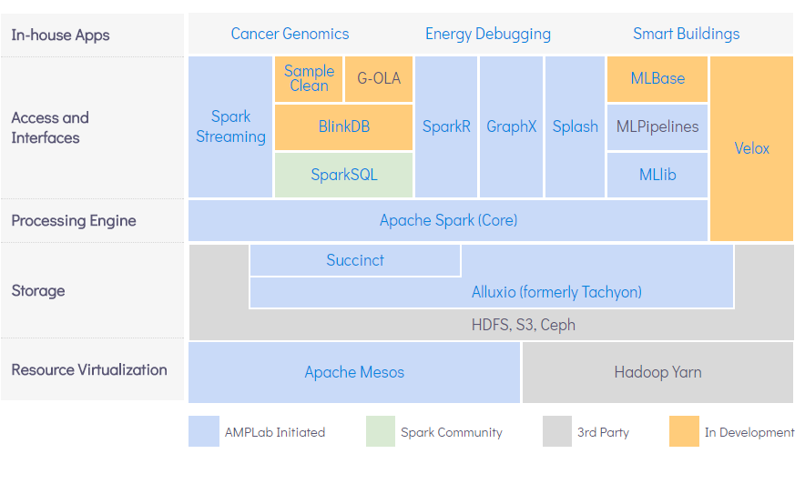
UC BERKELEY Research Projects – AMPlab (Ended)
BDAS (the Berkeley Data Analytics Stack)
Ref: https://amplab.cs.berkeley.edu/software/

Slide 3

UC BERKELEY Research Projects – RISELab (In Progress)
Launched in January 2017: https://rise.cs.berkeley.edu/
Focus on creating open-source platforms for Real-time, Intelligent, Secure, Explainable, Systems:
RISELab Bootcamp will be on 11/12th of October 2018.
Some Interesting RISELab Projects:
Clipper is a general-purpose low-latency model serving system which can integrate with many ML frameworks including Spark MLlib.
Ray is a Python based distributed execution framework aims to facilitate to parallelize existing codebases.
Opaque aims to enable analytics on sensitive data in an untrusted cloud by encrypting Spark SQL Datasets.
Drizzle is a low latency execution engine for Apache, which unifies the record-at-a-time streaming and micro-batch (legacy API) streaming models in a hybrid streaming system.
Notes:
Clipper:
is a general-purpose low-latency prediction (model serving) system which can integrate with many ML frameworks.
https://rise.cs.berkeley.edu/projects/clipper/
https://github.com/ucbrise/clipper
Drizzle:
is a low latency execution engine for Apache Spark that is targeted at stream processing and iterative workloads. It unifies the record-at-a-time streaming and micro-batch (legacy API) streaming models in a hybrid streaming system. Currently, it is just a prototype.
https://rise.cs.berkeley.edu/projects/drizzle/
https://github.com/amplab/drizzle-spark
https://spark-summit.org/2016/events/low-latency-execution-for-apache-spark/
Ray:
is a Python based distributed execution framework aimed at making it easy to parallelize existing codebases.
Ray offers low latency scheduling and execution to efficiently support machine learning expanding the variety to deep learning and reinforcement learning applications.
https://rise.cs.berkeley.edu/projects/ray/
https://github.com/ray-project/ray
http://ray.readthedocs.io/en/latest/index.html
Opaque:
is a package for Apache Spark SQL that enables strong security for DataFrames using Intel SGX trusted hardware. The aim is to enable analytics on sensitive data in an untrusted cloud.
Opaque allows encrypting the contents of a DataFrame. Subsequent operations on them will run within SGX enclaves. It is currently an alpha release!
https://rise.cs.berkeley.edu/projects/opaque/
https://github.com/ucbrise/opaque

Slide 4
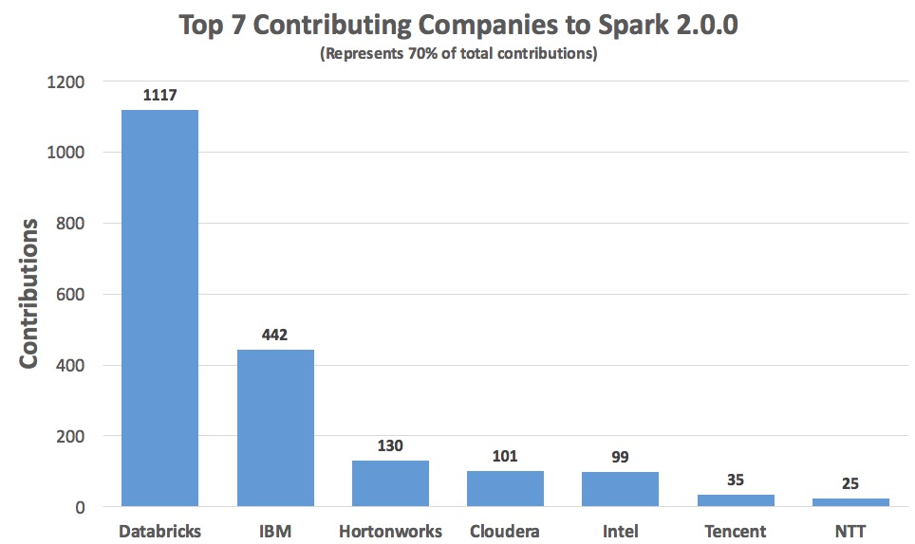
Corporate Contribution to Apache Spark
March 2017 Ref: https://www.slideshare.net/JohanPicard/a-short-introduction-to-spark-and-its-benefits

Slide 5


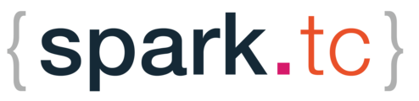


Contribution to Apache Spark
https://databricks.com/
https://www.ibm.com/analytics/us/en/technology/spark/
IBM Spark Technology Center:
http://www.spark.tc/
IBM Data Science Experience:
https://datascience.ibm.com/
https://databricks.com/sparkaisummit
Databricks Community Cloud:
https://community.cloud.databricks.com/
SparkHub:
https://sparkhub.databricks.com/

Slide 6
Session 1
Course Methodology & Logistics Overview
Spark: Background & Position in Big Data Analytics
Core Concepts & Challenges of Distributed Computing
Overview of Spark Components
Conceptual Introduction to Spark Application
Appendix

Slide 7
Purpose of Big Data Analytics
1- Hindsight → Metadata patterns emerging from historical data
2- Insight → Deep understanding of issues or problems
3- Foresight → Accurate prediction in near future in a cost-effective manner
Ref: Big Data: Principles and Paradigms, Chapter 1: Big Data Analytics = Machine Learning + Cloud Computing

Slide 8
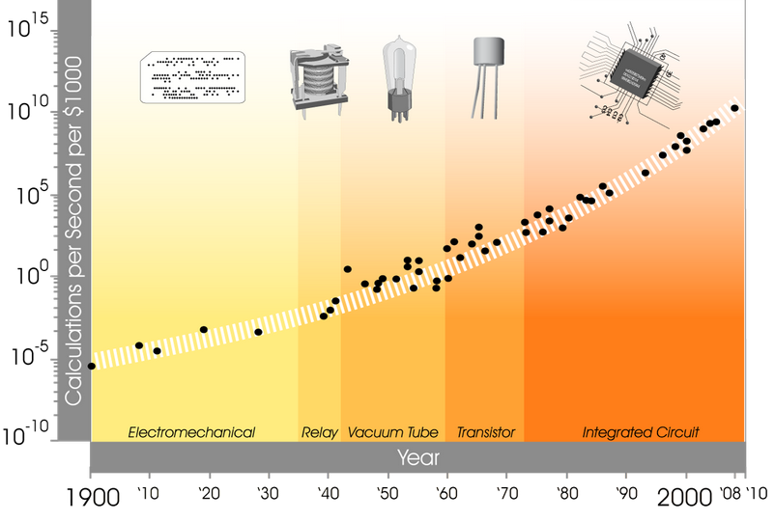
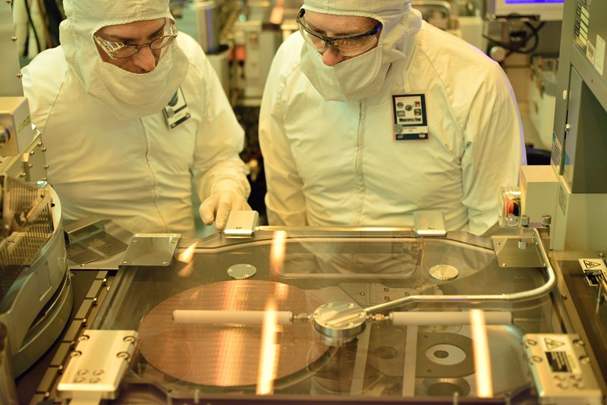
Moore’s Law (1/3)
Engineers at a processor fabrication plant
assessing a wafer
Processor fabrication is an expensive nanometer scale process,
which exploits cutting-edge material science, electromagnetics & optical technologies.
Ref: https://ourworldindata.org/technological-progress/
Notes:
https://www.technologyreview.com/s/601441/moores-law-is-dead-now-what/
https://eandt.theiet.org/content/articles/2017/05/moore-s-law-2017-an-uphill-battle/
https://ourworldindata.org/technological-progress/
A processor is basically composed of a silicon wafer topped with a photoresist layer that breaks down when exposed to ultra-violet light. A solvent is then applied to remove the exposed areas and create trenches in the silicon underneath.
So the light pattern beamed onto the top layer effectively shapes the structure of the underlying silicon, a nanoscale circuit diagram composed of billions of transistors and their interlinking pathways.
The trenches formed are then filled with electricity-conducting ions that allow current to be directed through the transistors, which can act in either an on or off state.
This on/off paradigm effectively creates the binary system that is the basis for all computer code

Slide 9
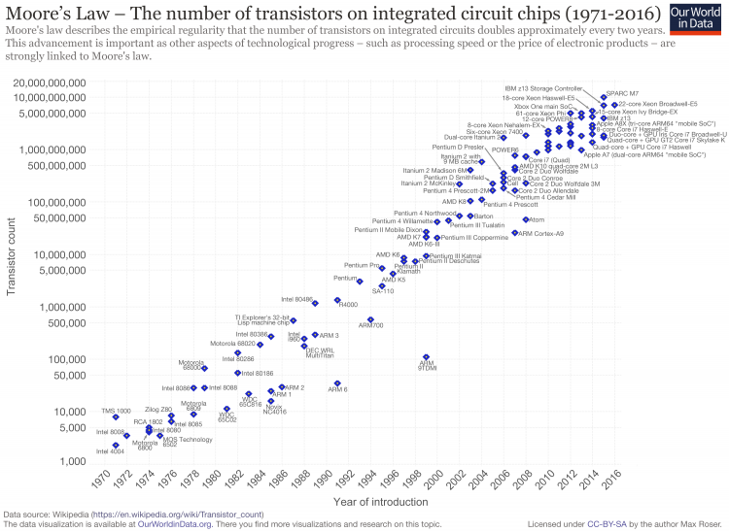
Moore’s Law (2/3)
According to Moore’s Law, there will be an exponential growth with transistor count doubling every two years.
Nowadays, there is a serious debate on validity of Moore’s Law between hardware vendors and other stakeholders.
Doubling the transistor density (thereby CPU Clock Speed) each two years is getting more technically complicated and costly.
Ref: https://ourworldindata.org/technological-progress/
Note: Logarithmic scale vertical axis chosen to show the linearity of the growth rate.
Notes:
https://www.technologyreview.com/s/601441/moores-law-is-dead-now-what/
https://eandt.theiet.org/content/articles/2017/05/moore-s-law-2017-an-uphill-battle/
https://ourworldindata.org/technological-progress/
A processor is basically composed of a silicon wafer topped with a photoresist layer that breaks down when exposed to ultra-violet light. A solvent is then applied to remove the exposed areas and create trenches in the silicon underneath.
So the light pattern beamed onto the top layer effectively shapes the structure of the underlying silicon, a nanoscale circuit diagram composed of billions of transistors and their interlinking pathways.
The trenches formed are then filled with electricity-conducting ions that allow current to be directed through the transistors, which can act in either an on or off state.
This on/off paradigm effectively creates the binary system that is the basis for all computer code

Slide 10
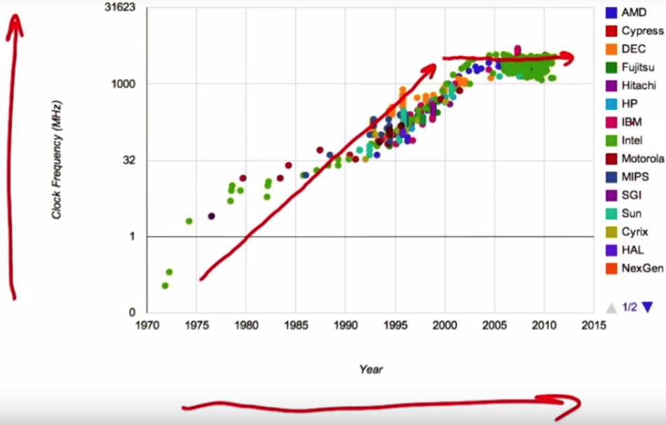
Moore’s Law (3/3)
Increase in processor clock rates has been the primary driver of processor performance, but over the last decade clock speeds remained constant. (hardly reached to 5GHz in 2018)
Increase in clock rates is not the only criterion of processing power per dollar.
As higher transistor density means:
Higher temperature & less reliability. → expensive chips and cooling systems
More power consumption → increases costs, sometimes we need low energy processors (IoT)
Notes:
Historically, as transistors improved, processor designers would then the clock rates of processors, running them faster and faster every year.
Let's take a look at this diagram of clock speeds over the years.
So again, we have time going on this axis, okay? So, a long time ago, Here we have clock frequency—how fast we're clocking these
Historically, one of the primary drivers of clock performance has been clock speed increases.
We see over many years, we see clock speeds continue to go up.
However, over the last decade we see that clock speeds have essentially remained constant.

Slide 11
Variations of Hardware for Parallelism
Parallel Data Processing Hardware:
Multi-core Processors (CPU)
Symmetric Multiprocessors (CPU)
General Purpose Graphics Processing Unit (GPU)
Field-Programmable Gate Arrays (FPGA)
Tensor Processing Unit (TPU/ ASICs)
Storage Hardware for Data Parallelism:
Random Access Memory
SSD Disks
SATA Disks
Network Attached Storage
Storage Area Network
Computer Clusters with many hosts/nodes

Slide 12
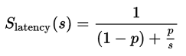
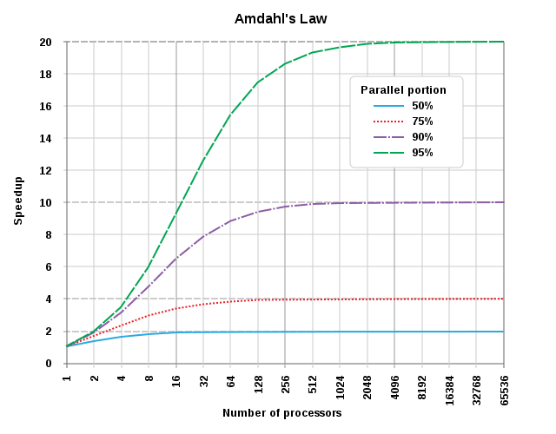
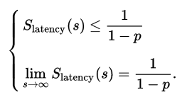
The “theoretical speedup” of the
execution of the whole task
Amdahl’s Law
The theoretical speedup by parallelism is always limited by the part of the task that cannot benefit from the improvement !
Ref: https://en.wikipedia.org/wiki/Amdahl%27s_law
Notes:
1-Amdahl’s law defines the máximum improvement gained by parallel processing
2-Improvements are limited to the code (and implicitly tasks) that can be parallelized
3-Contention limits parallelism therefore reduces the improvements.
Amdahl's law can be formulated as in the 1st formula
where
S_{latency} is the theoretical speedup of the execution of the whole task;
s is the speedup of the part of the task that benefits from improved system resources;
p is the proportion of execution time that the part benefiting from improved resources originally occupied.
Furthermore,
2nd formula shows that the theoretical speedup of the execution of the whole task increases with the improvement of the resources of the system and that regardless of the magnitude of the improvement, the theoretical speedup is always limited by the part of the task that cannot benefit from the improvement.
Amdahl's law applies only to the cases where the problem size is fixed. In practice, as more computing resources become available, they tend to get used on larger problems (larger datasets), and the time spent in the parallelizable part often grows much faster than the inherently serial work. In this case, Gustafson's law gives a less pessimistic and more realistic assessment of the parallel performance

Slide 13
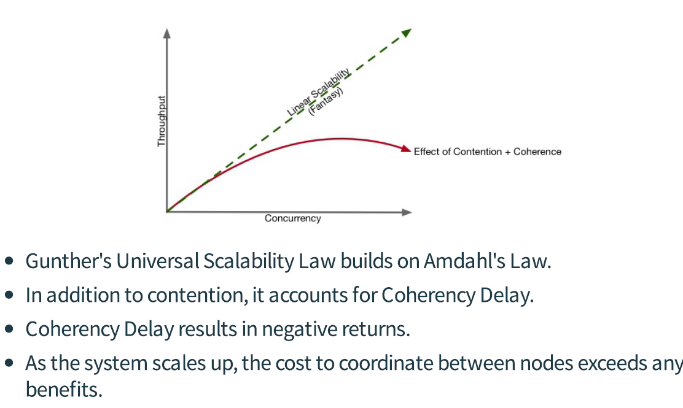
Gunther’s Universal Scalability Law

Slide 14

Women have always pioneered Computer Science!
Notes:
Video Address: https://youtu.be/3C0N4rBLNDk
Analogy:
Data: Snow
Each stair corresponds to different subsets of data.
Purpose: Removal of Snow from the stairs
Scarce Resources: Shovel & salt jug correspond to a processor and other system resources like memory which are occupied during a task
Shovelling & Salting correspond to different tasks which have the same purpose to remove the snow from the stairs

Slide 15
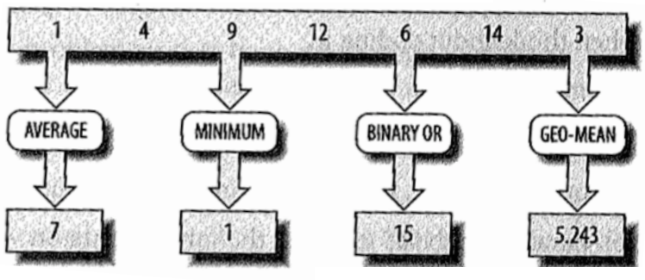
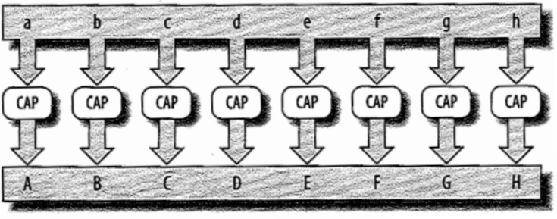
Types of Parallelism
Task Parallelism:
A form of parallelization that distributes different independent tasks on the same data across computing nodes/hosts.
Data Parallelism:
A form of parallelization that distributes data across computing nodes/hosts & executes the same task via independent invocations
over subsets/blocks of distributed data.
Hybrid Data & Task Parallelism:
A form of parallelization where
a parallel pipeline of tasks execute over the same subsets of distributed data.
Example: Several functions on the same data
Example: convert all characters
in an array to upper-case
Example: A ML algorithm may employ vertical data parallelism in the beginning of the algorithm and then it changes the parallelism type to task parallelism in the latter stage of the algorithm.
Platforms:
Apache Storm
Platforms:
Apache Spark (initially)
Apache MapReduce
Platforms:
Apache YARN
Apache Spark (recently)
Notes:
Task Parallelism Example – Several functions on the same data: average, minimum, binary or, geometric mean –
Key No dependencies between the tasks, so all can run in parallel
Data Parallelism Example: convert all characters in an array to upper-case – Can divide parts of the data between different tasks and perform the tasks in parallel –
Key: no dependencies between the tasks that cause their results to be ordered
Platforms according to Parallelism Pradigms:
https://books.google.es/books?id=BsreDAAAQBAJ&pg=PA54&lpg=PA54&dq=apache+spark+hybrid+parallelism&source=bl&ots=ZCsZa0hBdY&sig=UO-UOAfVfTuu3WVF86-uPbqDiHw&hl=es&sa=X&ved=0ahUKEwjgofvnhofWAhWIZlAKHbWQDjcQ6AEIMTAB
Hybrid Parallelism:
Hybrid parallelism combines more than one type parallelisms in the distributed algorithms. For example, an algorithm may employ vertical data parallelism in the beginning of the algorithm and then it changes the parallelism type to task parallelism in the latter stage of the algorithm.
Hybrid Parallelism Examples in Spark:
https://www.semanticscholar.org/paper/A-Parallel-Random-Forest-Algorithm-for-Big-Data-in-Chen-Li/baa643c70eb214852e83360d641afe518e8a4404
https://media.computer.org/transactions/featured/tpds_featured.pdf

Slide 16
Scaling Up versus Scaling Out
Large datasets can be analyzed and interpreted in two ways:
Distributed Processing – use many separate commodity nodes, where each analyze a portion of the data.
This method is sometimes called as scaling-out or horizontal scaling.
Potentially Low Infrastructure cost (CAPEX), High Maintenance cost (OPEX)
Shared Memory Processing – use large systems with enough resources (sometimes even specialized hardware) to analyze huge amounts of the data.
This method is sometimes called as scaling-up or vertical scaling.
Potentially High Infrastructure cost (CAPEX), Low Maintenance cost (OPEX)

Slide 17
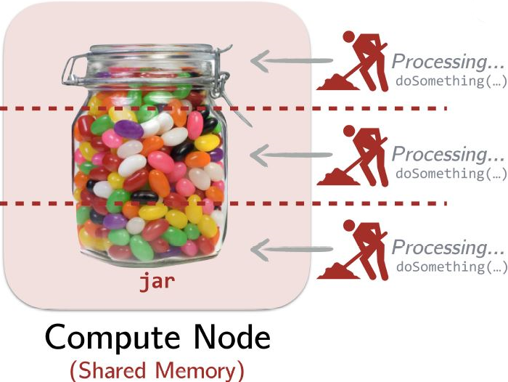
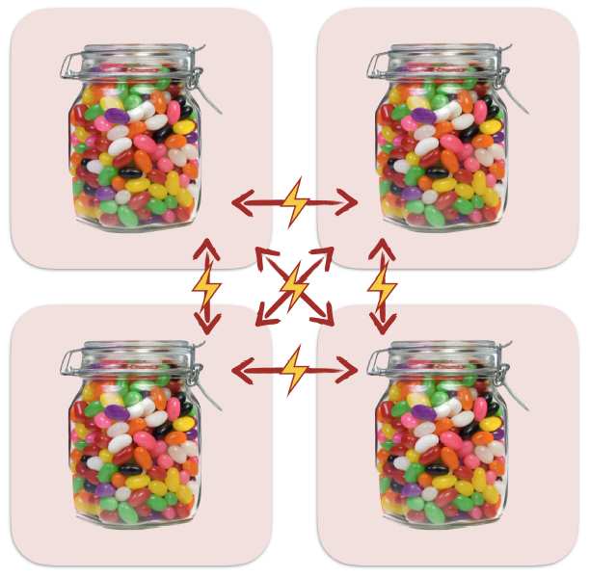
Data Parallelism
Shared Memory Data Parallelism
Distributed Data Parallelism
Node 1
Node 2
Block 1
Block 2
Node 3
Node 4
Block 3
Block 4
Data parallelism in a multi-core/multi-processor single machine
Data parallelism in a cluster with 2 or more machines
Notes:
Shared Memory Data Parallelism: Data partitioned in memory and operated upon in parallel. (Parallel Collections)
-Split the data
-Workers/threads independently opérate on the shards in parallel
-Combine when done if necessary
Distributed Data Parallelism: Data partitioned in machines, network in between, operated in parallel. However, like parallel collections we can keep corrections abstraction over distrubuted data parallel executions. (So this is hint about what is necessary to model a Resilient Distributed Dataset-RDD)
-Split data over several blocks and nodes
-Nodes independently opérate on data shards (in this case each shard will be a data block)
-Combine when done if necessary

Slide 18
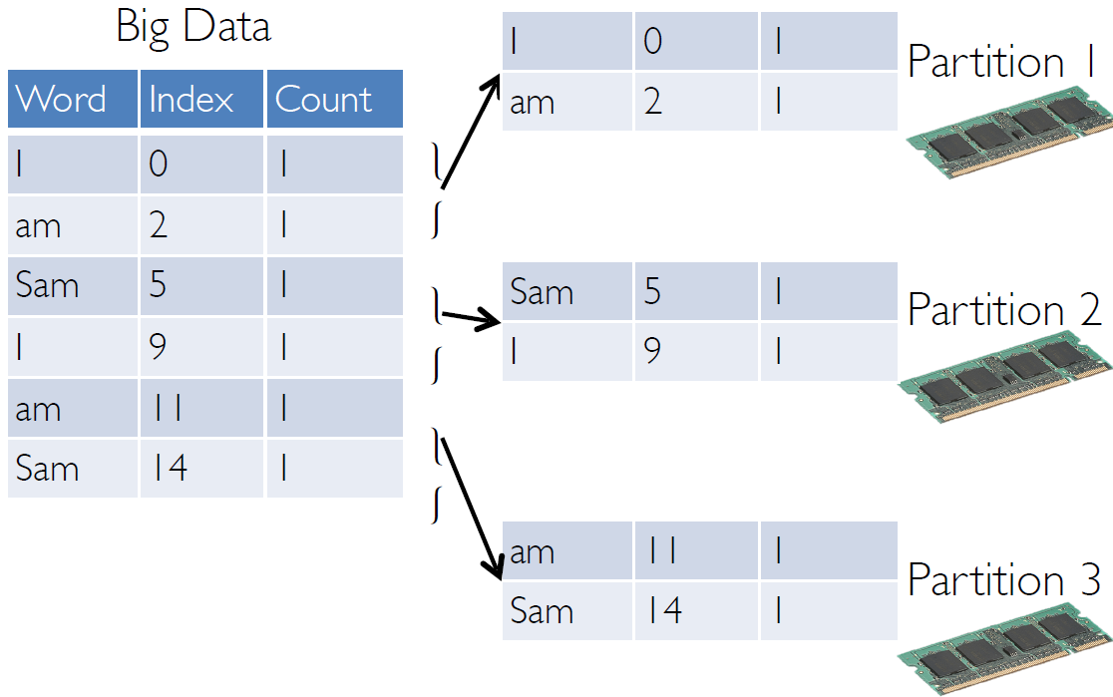
Data Parallelism Stored in Memory

Slide 19
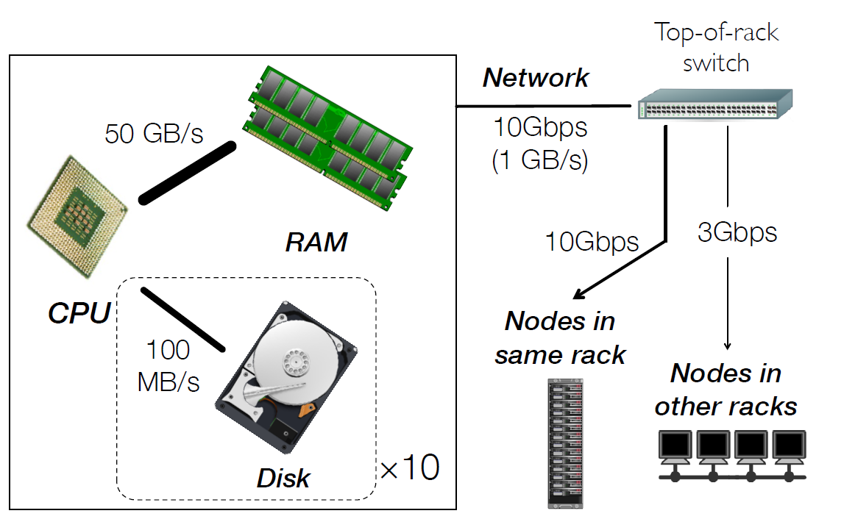
Communication Hierarchy in a Typical Data Center

Slide 20
Example Latency Results for Different Operations
Reference Data Tasks | Latency | Multiplied by 1 billion
L1 CPU cache reference | 0.5 ns | 0.5 s
Branch mispredict | 5 ns | 5 s
L2 CPU cache reference | 7 ns | 7 s
Mutex lock/unlock | 25 ns | 25 s
Main memory reference | 100 ns | 100 s
Send 2KBs over 1 Gbps network | 20,000 ns= 20 μs | 5.5 hr
SSD (Fast Disk) Random Read | 150,000 ns= 150 μs | 1.7 days
Read 1 MB sequentially from memory | 250,000 ns= 250 μs | 2.9 days
Rountrip within the same datacenter network | 500,000 ns= 0.5 ms | 5.8 days
Read 1 MB sequentially from SSD (Fast Disk) | 1,000,000 ns= 1 ms | 11.6 days
SATA Disk Seek | 10,000,000 ns= 10 ms | 16.5 weeks
Read 1 MB sequentially from SATA Disk | 20,000,000 ns= 20 ms | 7.8 months
Send packet US -> Europe -> US | 150,000,000 ns= 150 ms | 4.8 years
Memory
Intensive
Disk
Intensive
Network
Intensive
Original compilation by Jeff Dean & Peter Novig

Slide 21
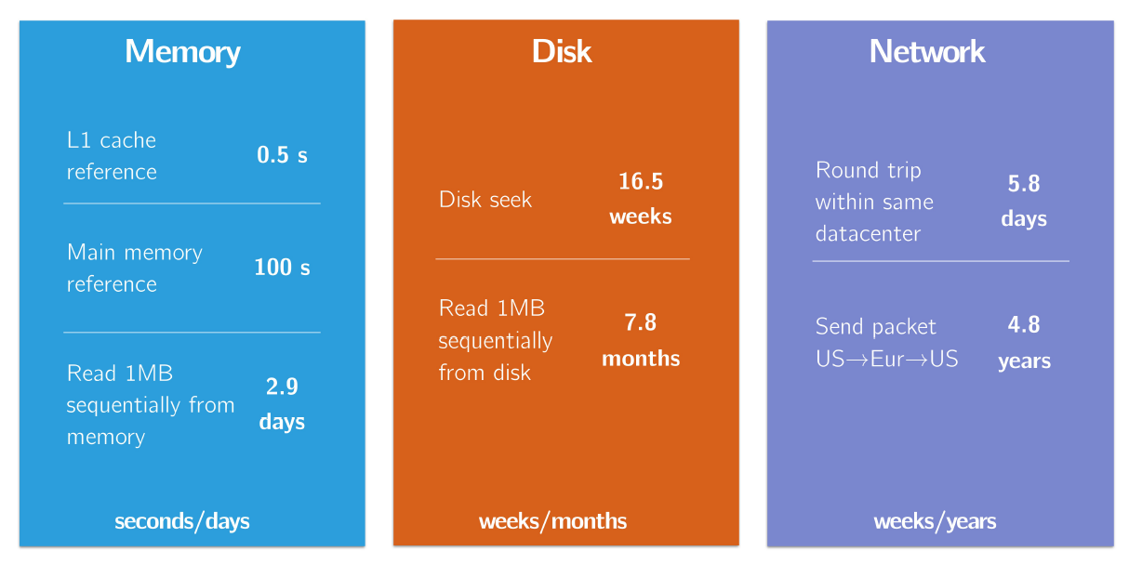
Latency in a real life big data scenario (Multiplied with 1 Billion)

Slide 22
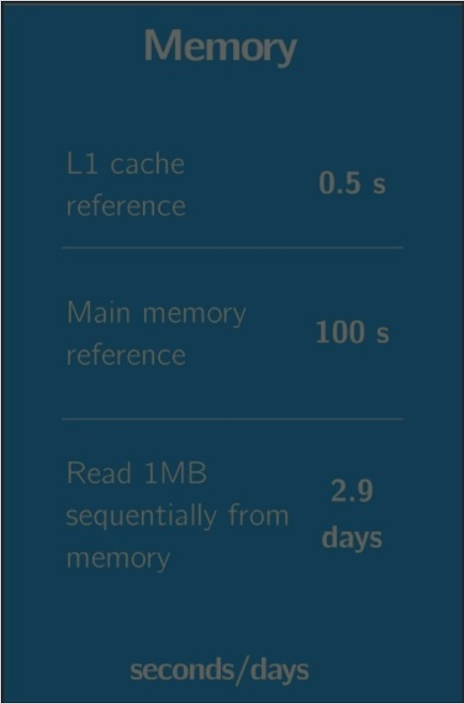
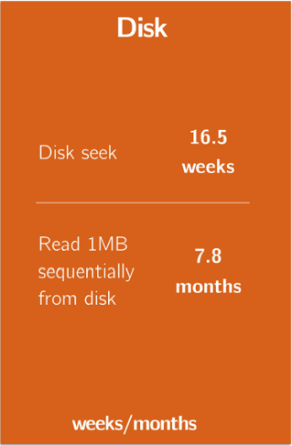
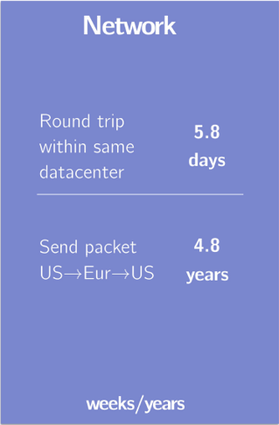

Latency in Hadoop MapReduce (Multiplied with 1 Billion)

Slide 23
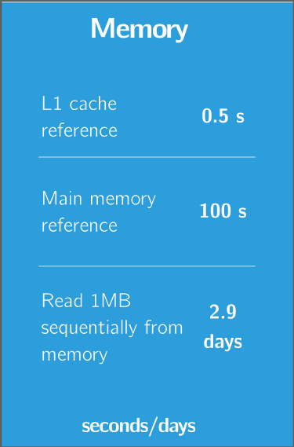
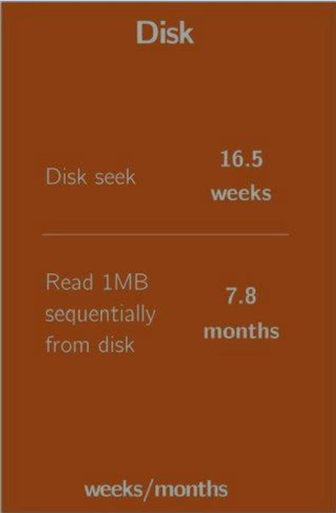
Latency in Spark (Multiplied with 1 Billion)
Aggresive usage of memory by Spark Datasets!
Optional usage of disk if needed!
Aggresively minimized data shuffling over the network !

Slide 24
Challenges of Distributed Systems (1/2)
Latency
Data storage, reading & transfer operations might have significant difference based on the involvement of different computer hardware
Distributed Data Abstraction & Handling:
We must consider network, data locality*
Transfering data between nodes or processes may be very time consuming depending on your network bandwith
Note:* Data locality became less of your concern with Terabit/Petabit per second Network Bandwith in Cloud Platforms

Slide 25
Challenges of Distributed Systems (2/2)
Fault Tolerance:
Process & Node Failures:
Likelihood of singe machine’s failure is very high for commodity hardware.
Note: Imagine 1 server fails every 3 years with 10,000 nodes you would observe 10 faults/day
It is also necessary to deal with the nodes with poor performance (in terms of speed, space etc.)
Network Failures:
Dropped messages
Lost Partitions
Network Congestions
Routing Errors

Slide 26
Fault Tolerance in Hadoop versus Spark
Fault tolerance in Hadoop MapReduce framework has an additional cost. Between each map & reduce step, as a safeguard against potential failures, intermediary data outputs have to be written / serialized to disk.
Spark keeps all data in immutable,
in-memory* and lazily evaluated variables / collections called RDDs.
Spark keeps the data lineage (récipe) of these in memory datasets across all pipeline, so that in case of a failure during processing, it replays all this récipe (RDD Lineage) up to the immutable source dataset**.
Notes:
* Spark has many data storage modes, as it will be mentioned during this course. However, Spark creates in-memory datasets by default unless configured for different behaviour or explicity instructed to export data.
**In case of failure, if an intermediary dataset in this récipe is cached, Spark recalculates up to the cached intermediay Dataset.

Slide 27
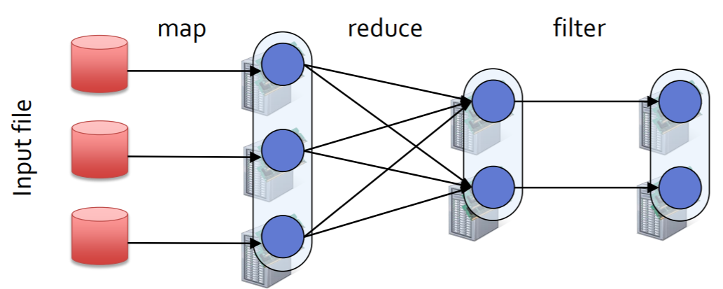
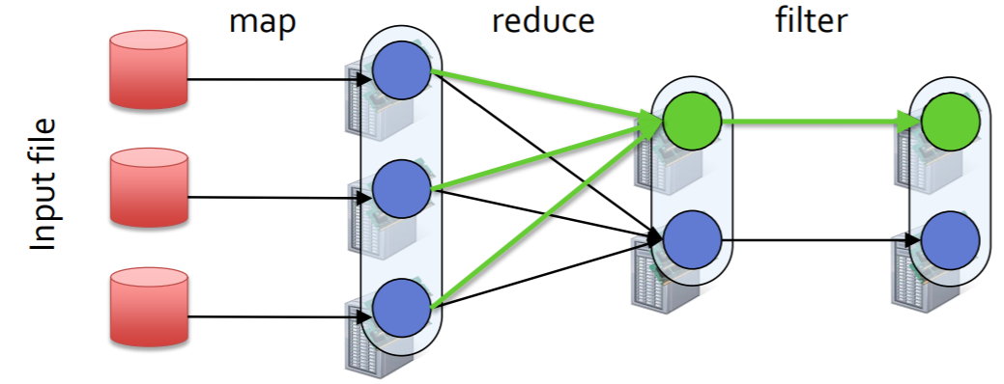
Fault Tolerance in Spark
Each Spark Dataset (RDD) keeps the lineage informartion which can be used to reconstruct the dataset in case of failure.
This example shows a mapped, reduced & filtered dataset block reconstructed using Spark dataset (RDD) lineage.

Slide 28
What Apache Spark is not? (1/3)
Not a Data Store:
Spark connects to other data stores but it does not provide its own database or filesystem.*
Spark can access & store data in HDFS, AWS S3, Google Cloud Storage, DBFS, Hbase, Hive, Alluxio, external SQL, NoSQL databases or any Hadoop data source
Not a Programming Language:
It is a unified Big Data Framework which provides an Application Programming Interface (API) for Scala, Java, Python, R and SQL. Nevertheless, it is built in Scala Programming Language.
Note:* We will learn the “Spark Storage” functionality and setting, it still doesn’t mean that Spark can be classified as a Data Store.

Slide 29
What Apache Spark is not? (2/3)
Not only for Big Data SQL:
It is also used for Machine Learning, Streaming and Graph Analytics at scale.
Not a substitute for all Hadoop Big Data Ecosystem:
It is correct that is a substitute for Hadoop MapReduce, Pig, Sqoop, Hive and Tez, Mahout, but it is also common to integrate it with HDFS, Hive Metastore, Oozie, Kafka, Solr, Hbase, NIFI etc.

Slide 30
What Apache Spark is not? (3/3)
Not only for Hadoop :
Spark can work with Hadoop & Yarn, but Spark is a standalone system
Spark Application Code can also be executed on Mesos (DC/OS), Kubernetes, Databricks Runtime, AWS Glue as an alternative to any Hadoop Distribution.
Not only for Streaming & Real-time Analytics:
Apache Spark is oftenly used for In-Memory Batch Processing, apart from being an alternative to Storm, Flink, Beam, Samza, Heron, Ignite (which are streaming tools).

Slide 31
Programming Models for Big Data
A Programming Model is an abstraction or existing machinery or infrastructure.
It is a set of abstract runtime libraries and programming APIs that form a model of computation.
MapReduce and Spark are Big Data Programming Models.
Traits of a Big Data Programming Model:
Splitting large volumes of data
Fast access to data
Scalable & fast distribution to nodes
Enabling reliability of the computing and full tolerance from failures
Allowing to add new resources
Enable operations over a particular set of these types
Notes:
Programming Models for Big Data. We have seen that scalable computing over the internet to achieve data-parallel scalability for big data applications is now a possibility. Thanks to commodity clusters. Cost-effective commodity clusters together with advances in distributed file systems to move computation to data, provide a potential to conduct scalable big data analytics. The next thing we will talk about is how to take advantage of these infrastructure advances. What are the right programming models? A programming model is an abstraction or existing machinery or infrastructure. It is a set of abstract runtime libraries and programming languages that form a model of computation. This abstraction level can be low-level as in machine language in computers. Or very high as in high-level programming languages, for example, Java. So we can say, if the enabling infrastructure for big data analysis is distributed file systems as we mentioned, then the programming model for big data should enable the programmability of the operations within distributed file systems. What we mean by this being able to write computer programs that work efficiently on top of distributed file systems using big data and making it easy to cope with all the potential issues. Based on everything we discussed so far, let's describe the requirements for big data programming models:
1-First of all, such a programming model for big data should support common big data operations like splitting large volumes of data→ This means for partitioning and placement of data in and out of computer memory along with a model to synchronize the datasets later on.
2-The access to data should be achieved in a fast way→ Proper arrangement of storage resources, partitioning, hashing and data locality
3-It should allow fast distribution to nodes within a rack and these are potentially, the data nodes we moved the computation to. →This means scheduling of many parallel tasks at once.
4-It should also enable reliability of the computing and full tolerance from failures. →This means it should enable programmable replications and recovery of files when needed. It should be easily scalable to the distribute nodes where the data gets produced.
5-It should also enable adding new resources to take advantage of distributive computers and scale to more or faster data without losing performance. This is called scaling out if needed.
6-Since there are a variety of different types of data, such as documents, graphs, tables, key values, etc. A programming model should enable operations over a particular set of these types. Not every type of data may be supported by a particular model, but the models should be optimized for at least one type.
Programming Models for Big Data:
https://www.coursera.org/learn/big-data-introduction/lecture/7WaCA/programming-models-for-big-data
https://books.google.com.tr/books?id=fPsN9dwCI6IC&pg=PA221&lpg=PA221&dq=MapReduce+Iterative+MapReduce+DAG+programming+models&source=bl&ots=rik3DzZWfr&sig=oWtr59NMH2tBlHqjUrHHOOoT9CM&hl=es&sa=X&ved=0ahUKEwiL08W07e3VAhUoDZoKHWNeCFwQ6AEIeDAI#v=onepage&q=MapReduce%20Iterative%20MapReduce%20DAG%20programming%20models&f=false
https://search-proquest-com.ezxy.ie.edu/docview/963530023/citation/7CD0054D04204742PQ/1?accountid=27285 (IE library)
https://books.google.com.tr/books?id=IjgVAgAAQBAJ&pg=PA342&lpg=PA342&dq=MapReduce+Iterative+MapReduce+DAG+programming+models&source=bl&ots=9QQGk-4E1u&sig=C6C2yr0Sx6JJkylnoZKhuwPsfHA&hl=es&sa=X&ved=0ahUKEwiL08W07e3VAhUoDZoKHWNeCFwQ6AEIUzAE#v=onepage&q=MapReduce%20Iterative%20MapReduce%20DAG%20programming%20models&f=false

Slide 32
The World of Big Data Tools
DAG Model
MapReduce Model
Graph Model
BSP/Collective Model
Hadoop
For Iterations/ Learning
MPI
HaLoop
Giraph
Twister
Hama
GraphLab
Spark
GraphX
Harp
Stratosphere
Dryad/ DryadLINQ
Reef
For Query
Pig/PigLatin
Hive
Drill
Tez
Shark
MRQL
For Streaming
S4
Storm
Samza
Spark Streaming
Notes:
You should remember DAG from Apache TEZ Project as well which should have been mentioned in your Hadoop class as an alternative execution engine for Hive.
Ref: http://www.sciencedirect.com.ezxy.ie.edu/science/article/pii/B9780128053942000076
7.3. Big Data Processing Systems and Platforms
In the era of Big Data, characterized by the unprecedented volume of data, the velocity of data generation, and the variety of the structure of data, support for large-scale data analytics constitutes a particularly challenging task. To address the scalability requirements of today’s data analytics, parallel shared-nothing architectures of commodity machines (often consisting of thousands of nodes) have been lately established as the de facto solution. Various systems have been developed mainly by the industry to support Big Data analysis, including MapReduce [12], Pregel [19], Spark [13], etc. In this section, we give a brief survey of some representative solutions.
7.3.1. Hadoop
Hadoop [20] is an open source Java implementation of MapReduce [12], which is a popular programming model for large-scale data processing proposed by Google. It runs on top of a distributed file system called HDFS, which splits input data into multiple blocks of fixed size (typically 64 MB) and replicates each data block several times across computing nodes. Users can submit MapReduce jobs to the Hadoop cluster. The Hadoop system breaks each job into multiple map tasks and reduce tasks, with its map tasks computed before its reduce tasks. Each map task processes (ie, scans and records) a data block and produces intermediate results in the form of key-value pairs.
Moreover, Hadoop has evolved to the next generation of Hadoop (ie, Hadoop MRv2) called YARN [15], as a large-scale data operating platform and cluster resource management system. There is a new architecture for YARN, which separates the resource management from the computation model. Such a separation enables YARN to support a number of diverse data-intensive computing frameworks including Dryad [21], Giraph [22], Spark [13], Storm [23], and Tez [24]. In YARNs architecture, there is a global master named ResourceManager (RM) and a set of per-node slaves called NodeManagers (NM), which forms a generic system for managing applications in a distributed manner. The RM is responsible for tracking and arbitrating resources among applications. In contrast, the NM has responsibility for launching tasks and monitoring the resource usage per slave node. Moreover, there is another component called ApplicationMaster, which is a framework-specific entity. It is responsible for negotiating resources from the RM and working with the NM to execute and monitor the progress of tasks. Particularly, all resources of YARN are requested in the form of container, which is a logical bundle of resources (eg, 1 CPUs, 2G memory). As a multitenant platform, YARN organizes user submitted applications into queues and share resources between these queues. Users can set their own queues in a configuration file provided by YARN.
7.3.2. Dryad
Dryad [21] is a distributed execution engine that simplifies the process of implementing data-parallel applications to run on a cluster. The original motivation for Dryad was to execute data mining operations efficiently, which has also lead to technologies such as MapReduce or Hadoop. Dryad is a general-purpose execution engine and can also be used to implement a wide range of other application types, including time series analysis, image processing, and a variety of scientific computations. The computation is structured as a directed graph: Programs are graph vertices, while the channels are graph edges. A Dryad job is a graph generator, which can synthesize any directed acyclic graph. These graphs can even change during execution in response to important events in the computation. Dryad handles job creation and management, resource management, job monitoring and visualization, fault tolerance, reexecution, scheduling, and accounting.
7.3.3. Pregel
Pregel [19] is a specialized model for iterative graph applications. In Pregel, a program runs as a series of coordinated supersteps. With each superstep, each vertex in the graph runs a user function that can update state associated with the vertex, change the graph topology, and send messages to other vertices for use in the next superstep. This model can express many graph algorithms, including shortest paths, bipartite matching, and PageRank.
7.3.4. Storm
Storm [23] is a distributed real-time computation system. In a similar way to how Hadoop provides a set of general primitives for doing batch processing, Storm provides a set of general primitives for doing real-time computation, which greatly eases the writing of parallel real-time computation. It can be used for processing messages and updating databases (stream processing), performing a continuous query on data streams and streaming the results into clients (continuous computation), parallelizing an intense query like a search query on the fly (distributed Remote Procedure Calls (RPC)), and more. Storm’s small set of primitives satisfies a stunning number of user needs. For example, Storm scales to massive numbers of messages per second. To scale a topology, all you have to do is add machines and increase the parallelism settings of the topology. As an example of Storm’s scale, one of Storm’s initial applications processed 1,000,000 messages per second on a 10-node cluster, including hundreds of database calls per second as part of the topology.
7.3.5. Spark
Spark [13] is a fast in-memory data processing system that achieves high performance for applications through caching data in memory (or disk) for data sharing across computation stages. It is achieved with the resilient distributed dataset (RDD) in-memory storage abstraction for computing data, which is a read-only, partitioned collection of records [ 25]. Each RDD is generated from data in stable storage or other RDDs through transformation operations such as map, filter, and reduceByKey. Notably, the transformation is a lazy operation that only defines a new RDD without immediately computing it. To launch RDD computation, Spark provides another set of actionoperations such as count, collect, and save, which return a value to the application or export data to a storage system. For RDD caching, Spark offers five storage levels, ie, memory only, memory and disk, memory only ser, memory and disk ser, and disk only. For a Spark application in execution, the Spark system will spawn a master called driver, which is responsible for defining and managing RDDs, and a set of slavers called executors, which perform the computations dynamically. The Spark applications can run on either YARN, Mesos, local, or standalone cluster modes. In this paper, we focus on the standalone cluster mode.
Referring to Pregel above, BSP refers to Bulk Synchronous Parallel Model.
Graph processing Bulk Synchonuous Model
https://www.cs.duke.edu/courses/spring13/compsci590.2/slides/lec14.pdf
A BSP computer consists of
components capable of processing and/or local memory transactions (i.e., processors),
a network that routes messages between pairs of such components, and
a hardware facility that allows for the synchronisation of all or a subset of components.
This is commonly interpreted as a set of processors which may follow different threads of computation, with each processor equipped with fast local memory and interconnected by a communication network. A BSP algorithm relies heavily on the third feature; a computation proceeds in a series of global supersteps, which consists of three components:
Concurrent computation: every participating processor may perform local computations, i.e., each process can only make use of values stored in the local fast memory of the processor. The computations occur asynchronously of all the others but may overlap with communication.
Communication: The processes exchange data between themselves to facilitate remote data storage capabilities.
Barrier synchronisation: When a process reaches this point (the barrier), it waits until all other processes have reached the same barrier.

Slide 33
MapReduce as a Programming Model
MapReduce is a programming
model used to process large
dataset workloads in parallel.
The basic strategy of MapReduce
is to divide and conquer.
MapReduce treats computation
as the evaluation of mathematic
functions. In essence,
Functional Programming in MapReduce
can avoid In-progress state and just list in-and-out states.
Actually, MapReduce Paradigm has some variations like Iterative MapReduce & Twister paradigms.
Ref: Big Data: Principles and Paradigms, Chapter 1: Big Data Analytics = Machine Learning + Cloud Computing
Notes:
MapReduce is a programming model used to process large dataset workloads. In contrast to imperative programming (describing computation as a bunch of statements to change program state), MapReduce treats computation as the evaluation of mathematic functions. In essence, functional programming can avoid state and just list in-and-out states.
The basic strategy of MapReduce is to divide and conquer. In order to perform different dataintensive
applications effectively with MapReduce on the GFS framework, Dean and Ghemawat [62]
presented a five-step process or programming model, as shown in Fig. 13.
Lin et al. [64] simplified this process down to three steps: mapping, shuffling, and reducing. As
shown in Fig. 13, the first step involves splitting the input file into three files. The second step is to generate
a process of a key/value pair by a user (or client) who specifies the function. In the above example,
it is to count the number of different letters (A, B, C, and D) with a corresponding quantity within each
split file. The first split file contains the letters “BAB.” The letter “A” is counted as 1 and letter “B”
is counted as 2. In the third step, the shuffling function is to generate an intermediate key/value pair,
which is to sort the same letter (or key) and quantity (or value) from different split files into one file.
The fourth step is to merge all intermediate values (3, 2, 1, and 2) associated with the same intermediate
key (A, B, C, and D). The final step aggregates these key/value pairs into one output file. Here, “key”
is equal to the different types of letters to be counted and “value” is equal to the quantity of each letter.
From a programming perspective, MapReduce has two other meanings; “mapping” is splitting for
distribution and “reducing” is shuffling and sorting in parallel. A major advantage of MapReduce
is its capability of shared-nothing data processing, which means all mappers can process its data
independently.
The characteristic of shared-nothing data processing enables MapReduce to run a simple program
across thousands or even millions of unreliable and homogeneous machines in parallel and to complete
a task in very short time. Theoretically speaking, it allows any programmer to access an almost
unlimited commodity type of computing resources instantly (theoretically) or within an acceptable
time frame (practically), eg, cloud infrastructure. Several Other platforms have implemented their own
MapReduce processing model such as MongoDB, CouchDB, Cloud MapReduce, and Aneka

Slide 34
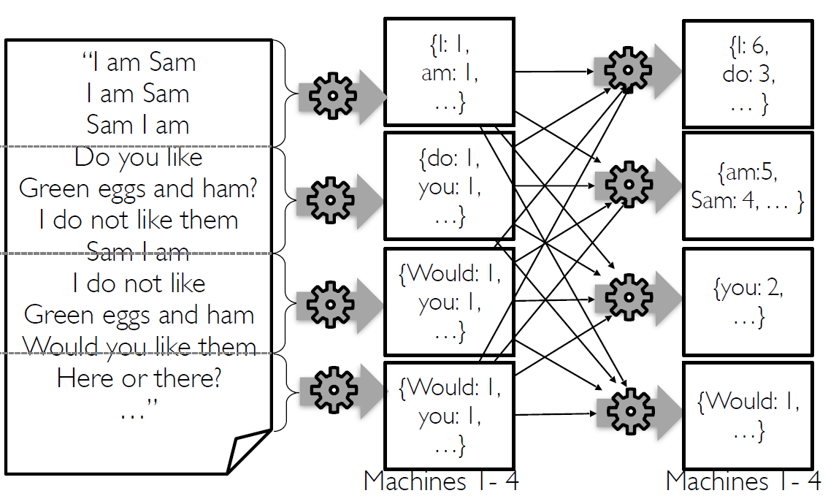
Modelling a massive Word Count problem in MapReduce (1/3)

Slide 35
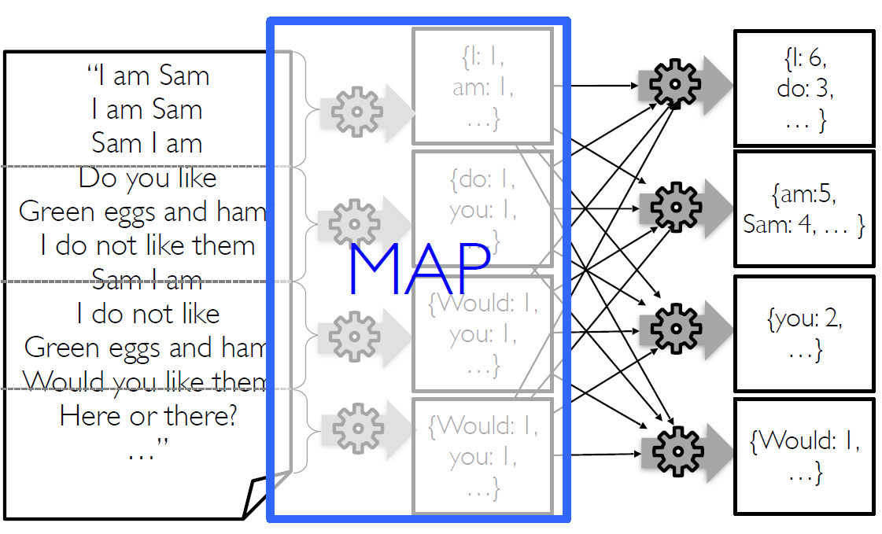
Modelling a massive Word Count problem in MapReduce (2/3)
“Mapping” requires splitting for
distribution.
map() is a high-order function from functional programming perspective which invokes a function/operation over each element of an Iterable/Collection.
In this example each element of the Iterable/Collection is a sentence; but it could be anything.
A major advantage of MapReduce is its shared-nothing data processing behaviour, which means all mapper tasks can process their data partitions independently and in parallel.
This enables a simple program to run across thousands or even millions of unreliable and homogeneous machines in parallel and to complete a large data processing task in an acceptable amount of time.

Slide 36
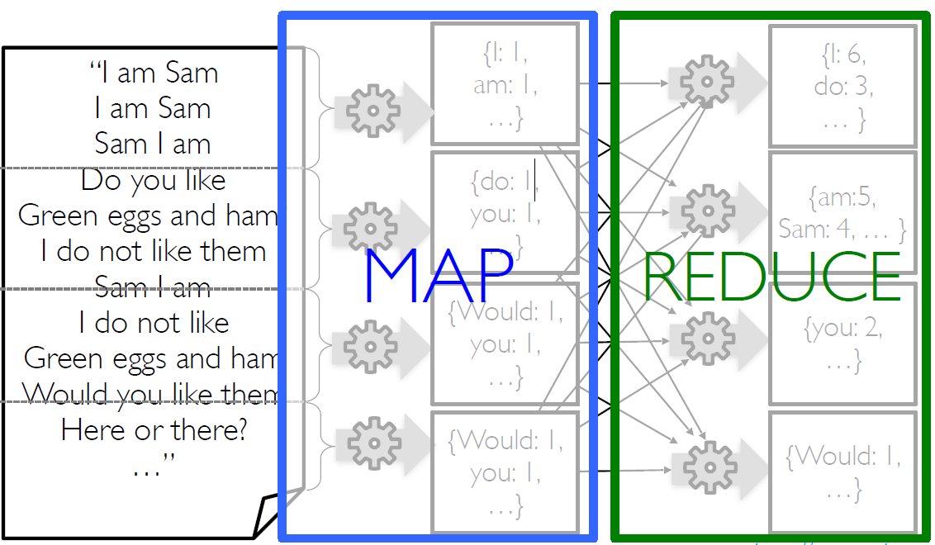
Modelling a massive Word Count problem in MapReduce (3/3)
“Reducing” might require shuffling between nodes and sorting in parallel.
reduce() is a high-order function from functional programming perspective which invokes a mathematically commutative & associative function/operation over a collection of elements grouped based on a criterion.
MapReduce Paper from Google: https://static.googleusercontent.com/media/research.google.com/en//archive/mapreduce-osdi04.pdf

Slide 37
Use Cases of MapReduce
MapReduce is potentially capable to handle five types of workloads:
1. Large-scale ML problems (usually via Mahout)
2. Clustering problems for Google News and Google products
3. Data Extraction to produce reports of popular queries (eg, Google Zeitgeist)
4. Feature Extraction of web pages for new experiments and products (eg, extraction of
geographical locations from a large corpus of web pages for localized search)
5. Large-scale graph computations (usually via Giraph)
Ref: Big Data: Principles and Paradigms, Chapter 1: Big Data Analytics = Machine Learning + Cloud Computing

Slide 38
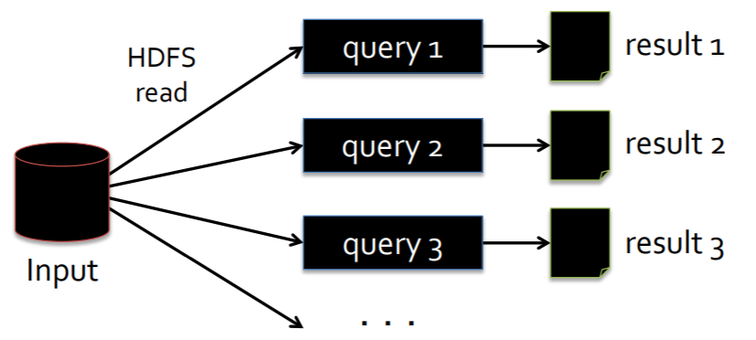
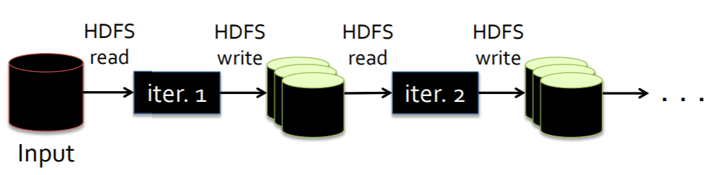
Drawbacks of MapReduce
MapReduce is not very efficient in performing:
An iterative and recursive process that is widely utilized for a simulation type of workload in ML
An interactive query during Exploratory Data Analysis tasks of Data Scientists.
Iterative Process in MapReduce
Interactive Query in MapReduce
Imagine training a Logistic Regression model seeking the best fit recalculating a gradient over a dataset.
Imagine a Data Scientist exploring the same massive dataset by executing queries on it.
Both of them can be quite cumbersome operations due to replication, serialization, Disk I/O Latency.

Slide 39
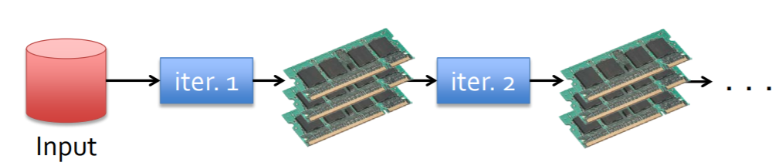
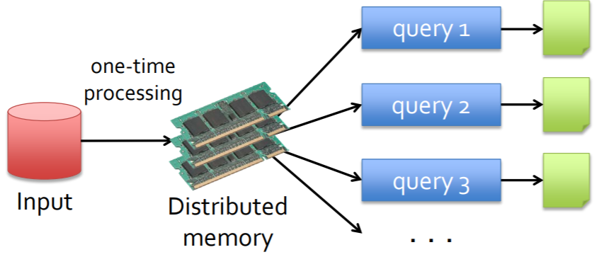
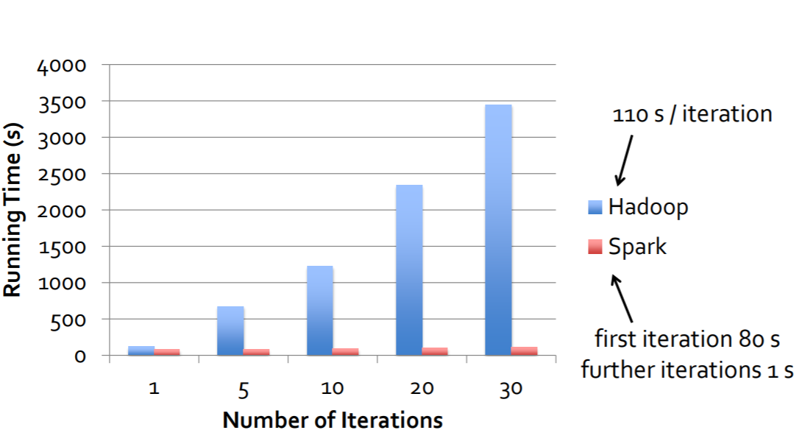
Iterative Processes & Interactive Queries in Spark
Iterative Processing in Spark
Interactive Query in Spark
Reference Data Tasks | Latency
Read 1 MB sequentially from memory | 250 μs
Read 1 MB sequentially from SSD (Fast Disk) | 1 ms
SATA Disk Seek | 10 ms
Read 1 MB sequentially from SATA Disk | 20 ms
Main Memory versus SSD:
250 μs versus 1ms
4x speedup
Main Memory versus SATA:
250 μs versus 10ms+20ms
120x speedup
Spark implementation of Logistic Regression
have run 100x faster than previous MapReduce
based implementations
Spark can accelerate an iterative or interactive task from 10x to 100x times compared to MapReduce !
Notes:
This includes two use cases where we have seen Hadoop users report that MapReduce is deficient:
• Iterative jobs: Many common machine learning algorithms apply a function repeatedly to the same dataset to optimize a parameter (e.g., through gradient descent). While each iteration can be expressed as a MapReduce/Dryad job, each job must reload the data from disk, incurring a significant performance penalty.
• Interactive analytics: Hadoop is often used to run ad-hoc exploratory queries on large datasets, through SQL interfaces such as Pig [21] and Hive [1]. Ideally, a user would be able to load a dataset of interest into memory across a number of machines and query it repeatedly. However, with Hadoop, each query incurs significant latency (tens of seconds) because it runs as a separate MapReduce job and reads data from disk.

Slide 40
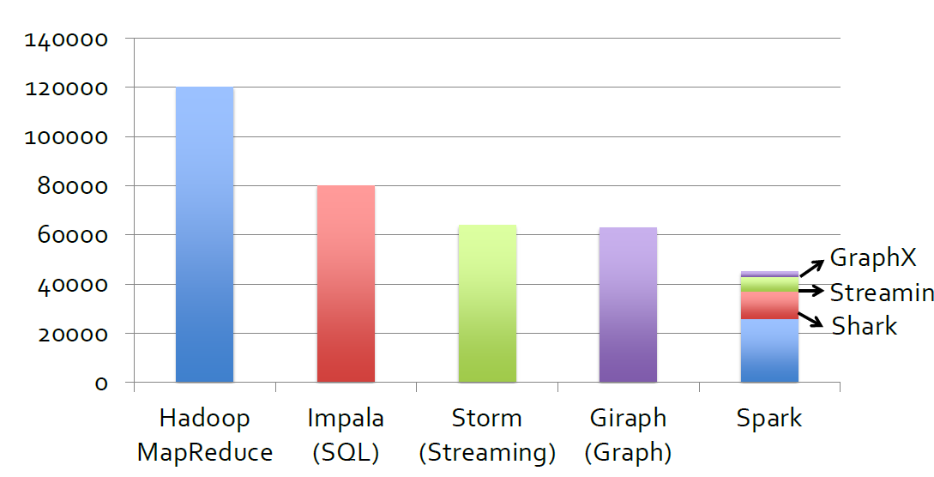
The Power of Unified BDA Engine: Code Size

Slide 41
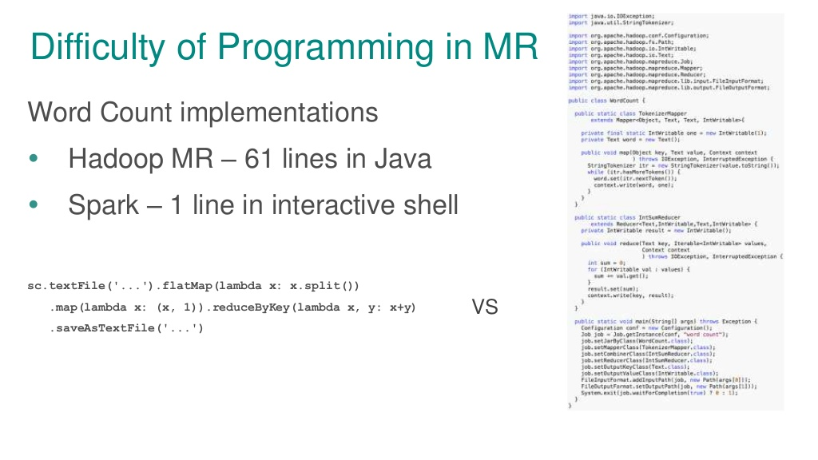
Ref: MapReduce WordCount Tutorial

Slide 42
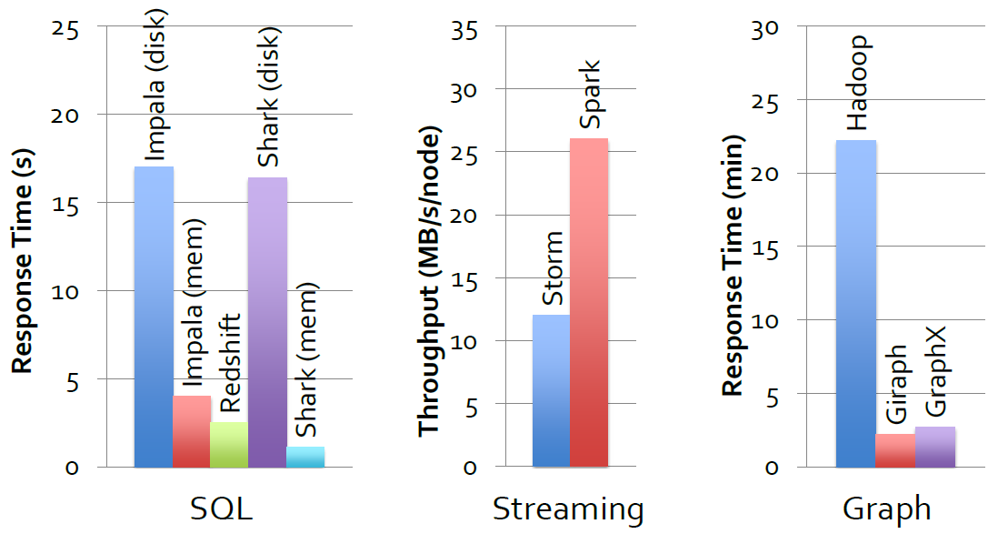
The Power of Unified BDA Engine: Performance

Slide 43
Session 1
Course Methodology & Logistics Overview
Spark: Background & Position in Big Data Analytics
Core Concepts & Challenges of Distributed Computing
Overview of Spark Components
Conceptual Introduction to Spark Application
Appendix

Slide 44
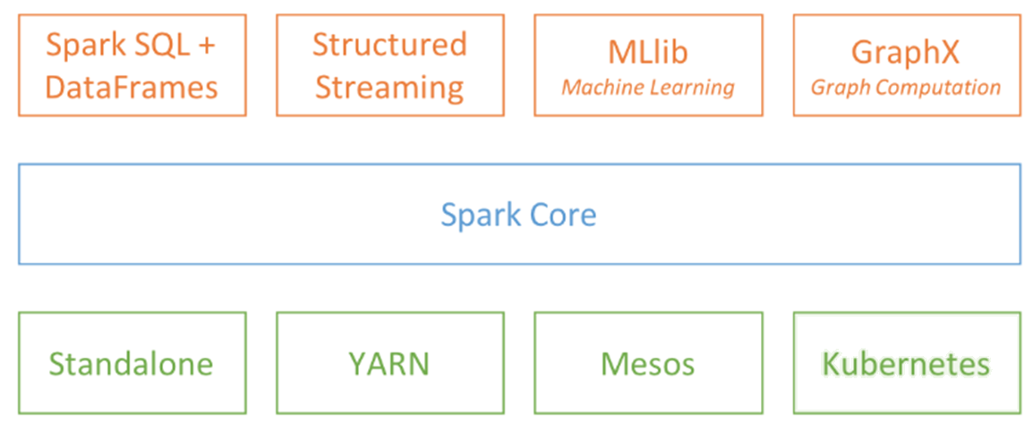
Apache Spark Components
SESSIONS 2 & 4

Slide 45
Spark Core
Spark Core contains the basic & core functionalities of Spark Applications like:
Task Scheduling
Memory Management
Fault Recovery
Interaction with Storage Systems
and other low level capabilities which support higher level Spark components like SQL, Streaming, Machine Learning and Graph processing.
Spark Core is the main component to process unstructured data (with exceptions such as in case of Image Data).
Spark Core API resides Resilient Distributed Datasets (RDDs).
Spark Core API provides different methods for building and manipulating RDDs.

Slide 46
Spark SQL (1/2)
Spark SQL is the main component to process structured & semi-structured data.
It allows querying data via SQL as well as Hive Query Language (HQL). Spark SQL supports ANSI SQL 2003 Standard.
Spark Dataframes are built-in in this component and they officially supported since version Spark 1.4. They are available for all programming languages.
Spark Datasets (Type-safe dataframes) are also built-in in this component and they are officially supported in version Spark 2.0. They are available for only Scala & Java as they are type-safe programming languages natively.
It supports many data sources, including Hive tables, external databases, Parquet, Avro, CSV, XML and JSON file formats and many more

Slide 47
Spark SQL (2/2)
Spark SQL is built-on Spark Core but Spark SQL is the basis of the optimizations and main API for user friendly Spark Components like Structured Streaming, Dataframe based Spark MLlib or or third-party projects like Graphframes, Tensorframes etc.
Beyond providing a SQL interface to Spark, Spark SQL allows developers to intermix SQL queries with the functions and standard of data science libraries supported by RDDs in Python, Java, and Scala, all within a single application. Thus it is possible to intermix Spark SQL with streaming data, complex analytics, functional & sometimes even object oriented programming.
This tight integration with the rich computing environment provided by Spark makes Spark SQL unlike any other open source data warehouse tool.

Slide 48
Spark Streaming (Streaming & Structured Streaming)
Spark Streaming enables processing of live streams of data (for example log files from a production web server, video steaming, sensor data or tweets from Twitter).
There are two streaming libraries in Apache Spark:
Spark Structured Streaming (Dataframe Based Streaming API with mini-batch or record-at-time options extending Spark SQL API)
Spark Streaming (RDD Based mini-batch Streaming API extending Spark Core API
Underneath its API, Spark Streaming was designed to provide the same degree of fault tolerance, throughput, and scalability as Spark Core.
If Spark Structured Streaming is used, then the performance, storage and usability efficiencies inherited from Spark SQL will be added.
It can be integrated with other stream processing tools like Apache Kafka, Apache Flume, Apache NIFI, AWS Kinesis, Google Pub/Sub etc.
Notes:
Apache Spark 2.0 adds the first version of a new higher-level API, Structured Streaming, for building continuous applications. The main goal is to make it easier to build end-to-end streaming applications, which integrate with storage, serving systems, and batch jobs in a consistent and fault-tolerant way. In this post, we explain why this is hard to do with current distributed streaming engines, and introduce Structured Streaming.

Slide 49
Spark Machine Learning (MLlib)
Spark comes with a component containing common machine learning and data analysis functionality, via model training via data & task (model) parallelism.
There are two built-in libraries in Apache Spark MLlib :
Dataframe based API is based on Spark SQL API
RDD based API is based on Spark Core API
Spark MLlib API involves several machine learning algorithms and statistical methods which are designed to scale out across a cluster.
Spark MLlib include variety of options for feature extraction & engineering, classification, regression, clustering, dimensionality reduction and collaborative filtering, as well as supporting functionality such as model evaluation and data import.
It offers model parallelism in model tuning as well as data parallelism for training and prediction.
Spark MLlib also provides some lower-level ML primitives for commonly used Optimization Algorithms.
Spark MLlib can be extended with third-party libraries which are designed to operate together.

Slide 50
Spark Graph Processing (GraphX & GraphFrames)
Spark Graph Processing is used for manipulating graphs and performing graph-parallel computations. (e.g., a social network’s friend graph, metro network in Madrid, or any dataset which is efficient or useful to be represented as graphs).
There are two graph processing libraries in Apache Spark:
GraphFrames (Dataframe based API extending Spark SQL)
GraphX (RDD based API extending Spark Core API)
Spark Graph Processing allows us to create directed & undirected graphs with arbitrary properties attached to each vertex and edge.
It also provides various operators for manipulating graphs (e.g., subgraph and mapVertices) and a library of common graph algorithms (e.g., PageRank and triangle counting, shortest path calculation).

Slide 51
Session 1
Course Methodology & Logistics Overview
Spark: Background & Position in Big Data Analytics
Core Concepts & Challenges of Distributed Computing
Overview of Spark Components
Conceptual Introduction to Spark Application
Appendix

Slide 52
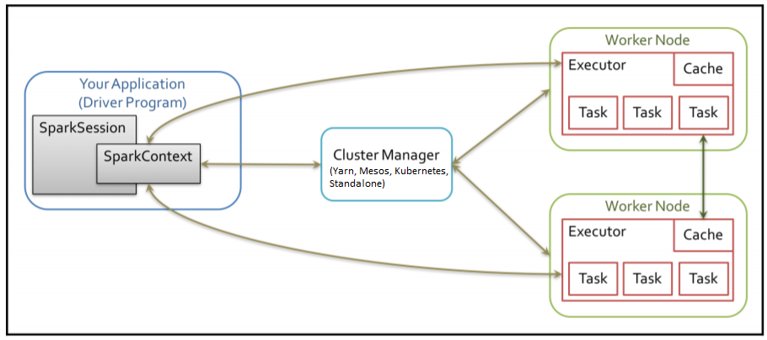
Spark Application – Basic Program Execution
Every Spark Application consists of a Driver Program with a Spark Session that launches various parallel data processing operations on a cluster.
Driver programs access Spark through a Spark Context object, which represents a connection to a computing cluster.
Driver program takes the program code and hands them over to a Cluster Manager.
The Cluster Manager, in turn, launches OS processes called Executors in multiple worker nodes, each having a set of tasks.
When Executors are launched, they are directly managed by the Driver Program.
Executors run the Tasks over each block/partition of RDDs.

Slide 53
Resilient Distributed Datasets (RDDs) (1/2)
Resilient Distributed Dataset (aka RDD) is the primary data abstraction in Apache Spark and the core of Spark (that I often refer to as "Spark Core").
A RDD is a resilient and distributed collection of records spread over one or many partitions.
The features of RDDs (decomposing the name):
Resilient, i.e. fault-tolerant with the help of RDD lineage graph and so able to re-compute missing or damaged partitions due to node failures.
Distributed with data residing on multiple nodes in a cluster.
Dataset is a collection of partitioned data with primitive values or values of values, e.g. tuples or other objects (that represent records of the data you work with).
Paper: Resilient Distributed Datasets: A Fault-Tolerant Abstraction for In-Memory Cluster Computing
Notes:
https://jaceklaskowski.gitbooks.io/mastering-apache-spark/spark-rdd.html
Beside the above traits (that are directly embedded in the name of the data abstraction - RDD) it has the following additional traits:
In-Memory, i.e. data inside RDD is stored in memory as much (size) and long (time) as possible.
Immutable or Read-Only, i.e. it does not change once created and can only be transformed using transformations to new RDDs.
Lazy evaluated, i.e. the data inside RDD is not available or transformed until an action is executed that triggers the execution.
Cacheable, i.e. you can hold all the data in a persistent "storage" like memory (default and the most preferred) or disk (the least preferred due to access speed).
Parallel, i.e. process data in parallel.
Typed — RDD records have types, e.g. Long in RDD[Long] or (Int, String) in RDD[(Int, String)].
Partitioned — records are partitioned (split into logical partitions) and distributed across nodes in a cluster.
Location-Stickiness — RDD can define placement preferences to compute partitions (as close to the records as possible).
Note
Preferred location (aka locality preferences or placement preferences or locality info) is information about the locations of RDD records (that Spark’s DAGScheduler uses to place computing partitions on to have the tasks as close to the data as possible).

Slide 54
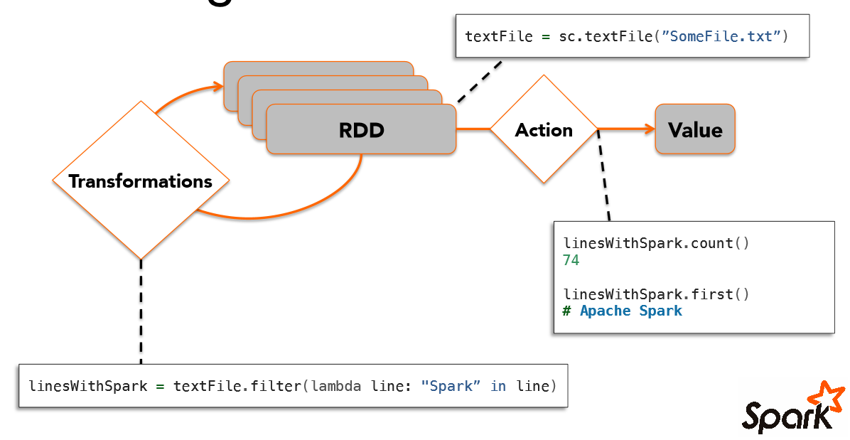
Resilient Distributed Datasets (RDDs) (2/2)
Notes:
https://jaceklaskowski.gitbooks.io/mastering-apache-spark/spark-rdd.html
Beside the above traits (that are directly embedded in the name of the data abstraction - RDD) it has the following additional traits:
In-Memory, i.e. data inside RDD is stored in memory as much (size) and long (time) as possible.
Immutable or Read-Only, i.e. it does not change once created and can only be transformed using transformations to new RDDs.
Lazy evaluated, i.e. the data inside RDD is not available or transformed until an action is executed that triggers the execution.
Cacheable, i.e. you can hold all the data in a persistent "storage" like memory (default and the most preferred) or disk (the least preferred due to access speed).
Parallel, i.e. process data in parallel.
Typed — RDD records have types, e.g. Long in RDD[Long] or (Int, String) in RDD[(Int, String)].
Partitioned — records are partitioned (split into logical partitions) and distributed across nodes in a cluster.
Location-Stickiness — RDD can define placement preferences to compute partitions (as close to the records as possible).
Note
Preferred location (aka locality preferences or placement preferences or locality info) is information about the locations of RDD records (that Spark’s DAGScheduler uses to place computing partitions on to have the tasks as close to the data as possible).

Slide 55

Transformations versus Actions
Actions are eagerly executed operations which initiate the real computation on a input RDD
to produce a Scalar or Collection Output
Transformations are lazily evaluated operations,
they transform one or more input RDD to an output RDD

Slide 56
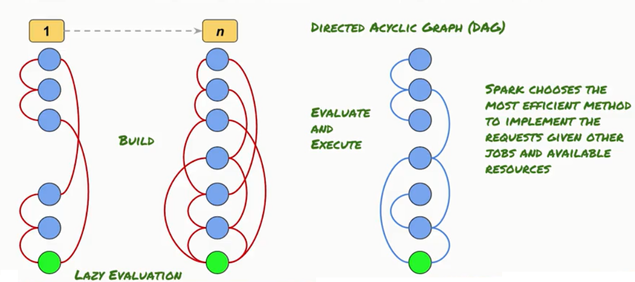
Lazy Evaluation and DAG

Slide 57
Spark Job Scheduling Process
RDD Objects
DAGScheduler
TaskScheduler
Worker
Cluster manager
Threads
DAG
TaskSet
Task
Block manager
rdd1.join(rdd2) .groupBy(…)
.filter(…)
split graph into stages of tasks
launch tasks via cluster manager
execute tasks
submit each stage as ready
retry failed or straggling tasks
store and serve blocks
build operator DAG
agnostic to operators!
stage failed
doesn’t know about stages
Notes:
https://spark.apache.org/docs/latest/cluster-overview.html#glossary

Slide 58
Generality of Spark RDDs
Spark RDD model is generic & flexible enough to implement the tasks suitables for several previous Big Data Programming Models in the same Spark code base:
MapReduce
Dryad
Pregel
Iterative MapReduce
GraphLab
SQL (Shark)
Allows apps to intermix these models
Notes:
Matei Zaharia et al. Resilient Distributed Datasets: A Fault-Tolerant Abstraction for In-Memory Cluster Computing. NSDI 2012.
RDDs can efficiently express a number of cluster programming models that have so far been proposed independently. By “efficiently,” we mean that not only can RDDs be used to produce the same output as programs written in these models, but that RDDs can also capture the optimizations that these frameworks perform, such as keeping specific data in memory, partitioning it to minimize communication, and recovering from failures effi- ciently. The models expressible using RDDs include:
MapReduce: This model can be expressed using the flatMap and groupByKey operations in Spark, or reduceByKey if there is a combiner.
DryadLINQ: The DryadLINQ system provides a wider range of operators than MapReduce over the more general Dryad runtime, but these are all bulk operators that correspond directly to RDD transformations available in Spark (map, groupByKey, join, etc).
SQL: Like DryadLINQ expressions, SQL queries perform data-parallel operations on sets of records.
Pregel: Google’s Pregel [22] is a specialized model for iterative graph applications that at first looks quite different from the set-oriented programming models in other systems. In Pregel, a program runs as a series of coordinated “supersteps.” On each superstep, each vertex in the graph runs a user function that can update state associated with the vertex, change the graph topology, and send messages to other vertices for use in the next superstep. This model can express many graph algorithms, including shortest paths, bipartite matching, and PageRank. The key observation that lets us implement this model with RDDs is that Pregel applies the same user function to all the vertices on each iteration. Thus, we can store the vertex states for each iteration in an RDD and perform a bulk transformation (flatMap) to apply this function and generate an RDD of messages. We can then join this RDD with the vertex states to perform the message exchange. Equally importantly, RDDs allow us to keep vertex states in memory like Pregel does, to minimize communication by controlling their partitioning, and to support partial recovery on failures. We have implemented Pregel as a 200-line library on top of Spark and refer the reader to [33] for more details.
Iterative MapReduce: Several recently proposed systems, including HaLoop [7] and Twister [11], provide an iterative MapReduce model where the user gives the system a series of MapReduce jobs to loop. The systems keep data partitioned consistently across iterations, and Twister can also keep it in memory. Both optimizations are simple to express with RDDs, and we were able to implement HaLoop as a 200-line library using Spark.
Batched Stream Processing: Researchers have recently proposed several incremental processing systems for applications that periodically update a result with new data [21, 15, 4]. For example, an application updating statistics about ad clicks every 15 minutes should be able to combine intermediate state from the previous 15- minute window with data from new logs. These systems perform bulk operations similar to Dryad, but store application state in distributed filesystems. Placing the intermediate state in RDDs would speed up their processing.
Explaining the Expressivity of RDDs
Why are RDDs able to express these diverse programming models? The reason is that the restrictions on RDDs have little impact in many parallel applications. In particular, although RDDs can only be created through bulk transformations, many parallel programs naturally apply the same operation to many records, making them easy to express. Similarly, the immutability of RDDs is not an obstacle because one can create multiple RDDs to represent versions of the same dataset. Indeed, many of today’s MapReduce applications run over filesystems that do not allow updates to files, such as HDFS. One final question is why previous frameworks have not offered the same level of generality. We believe that this is because these systems explored specific problems that MapReduce and Dryad do not handle well, such as iteration, without observing that the common cause of these problems was a lack of data sharing abstractions.

Slide 59





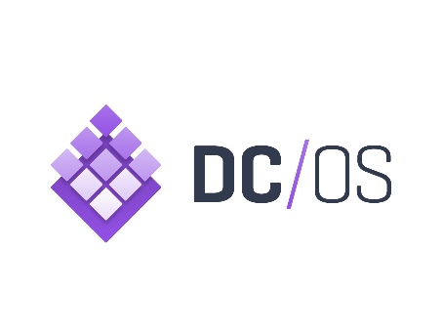




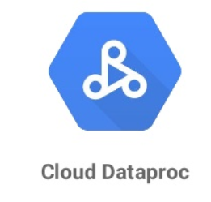

Spark & Cluster Managers
Running Spark On Yarn
Running Spark on Mesos
Running Spark On Kubernetes
Notes:
https://spark.apache.org/docs/latest/cluster-overview.html#glossary
https://dzone.com/articles/deep-dive-into-spark-cluster-management

Slide 60
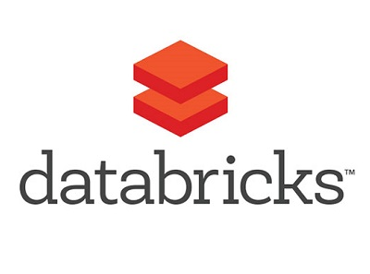

Spark on Serverless Platforms
Serverless Computing:
No need to setup or manage a server cluster
Automatic, dynamic and fine-grained scaling of resource pool according to processing needs
Better capacity utilization and billing based on sub-second usage in the cloud platforms
Sparkon a Serverless Platform is slower than on premise Spark Setups in terms of response time. This is due to the challenges of Serverless Computing:
Sub-Optimal Scheduling,
Container Start-up Time,
Remote Storage of Input Data,
Overhead of Intermediate Data Storage (shuffled, broadcasted)
Notes:
Serverless Machine Learning on Modern Hardware Using Apache Spark: https://databricks.com/session/serverless-machine-learning-on-modern-hardware-using-apache-spark
https://crail.incubator.apache.org/

Slide 61
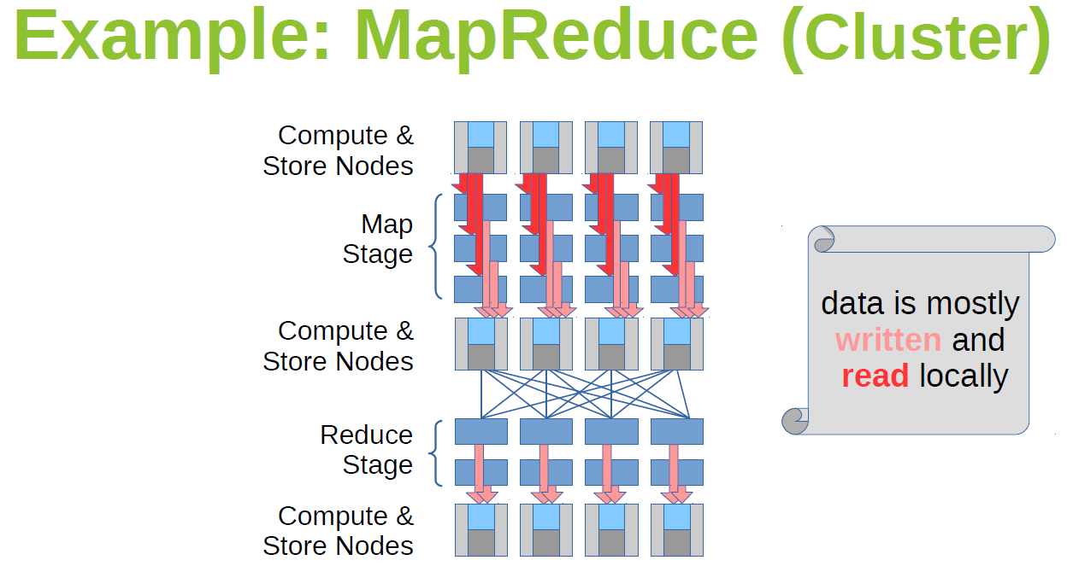
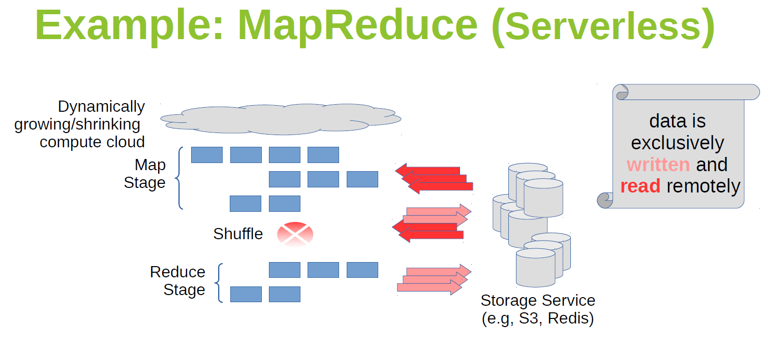
MapReduce on a Server Cluster or Serverless Platforms
Notes:
Serverless Machine Learning on Modern Hardware Using Apache Spark: https://databricks.com/session/serverless-machine-learning-on-modern-hardware-using-apache-spark

Slide 62
Session 1
Course Methodology & Logistics Overview
Spark: Background & Position in Big Data Analytics
Core Concepts & Challenges of Distributed Computing
Overview of Spark Components
Conceptual Introduction to Spark Application
Appendix

Slide 63
Easy Spark Installation with Python or R Package Managers
Spark itself is written in Scala, and runs on the Java Virtual Machine (JVM) and therefore to run Spark either on your laptop or a cluster, all you need is an installation of Java 1.8 or newer.
If you wish to use the Python API you will also need a Python interpreter (Python 3.5.x or newer).
Python Package Index:
https://pypi.org/project/pyspark/2.3.1/ → PPI is available only for versions Spark 2.2+
R Cran Libraries:
If you wish to use R you’ll also need a version of R on your machine. You have two library options:
1- sparklyr
2- SparkR

Slide 64
Manual Installation of Standalone Spark Application Framework
You can install Apache Spark 2.3.1 (latest stable version) to your local environment:
https://spark.apache.org/releases/spark-release-2-3-1.html
Important Notes:
You should have installed Python 3.6.x
You should have installed Java 1.8+
It is also recommended to install Scala 2.11.x (Not scala 2.10.x or 2.12.x)
Windows Installation might be a bit tricky:
https://hernandezpaul.wordpress.com/2016/01/24/apache-spark-installation-on-windows-10/

Slide 65
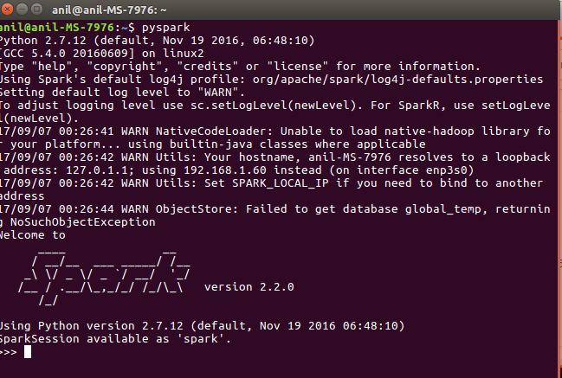
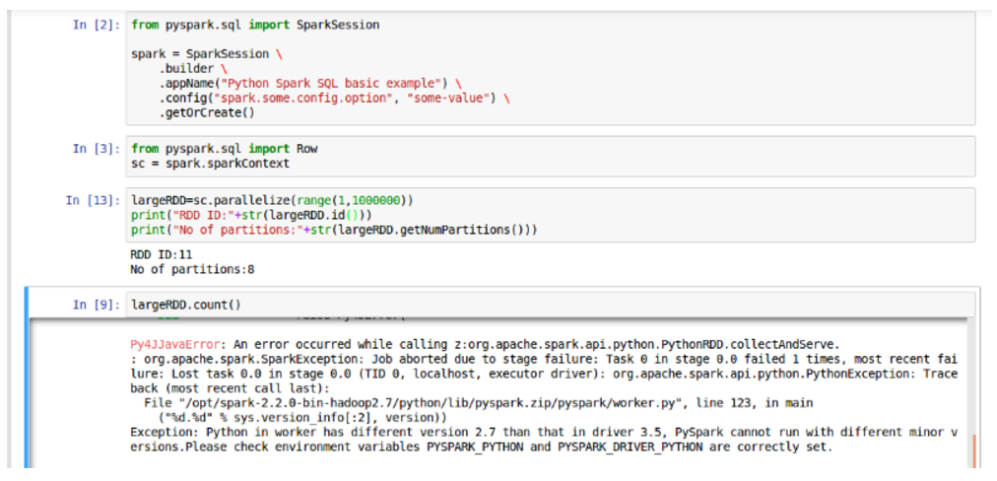
Standalone Spark Installation: Two potential problems, One Solution
Solution: https://mengdong.github.io/2016/08/08/fully-armed-pyspark-with-ipython-and-jupyter/

Slide 66


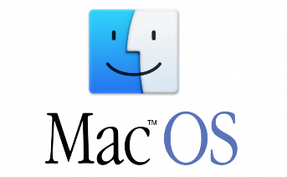
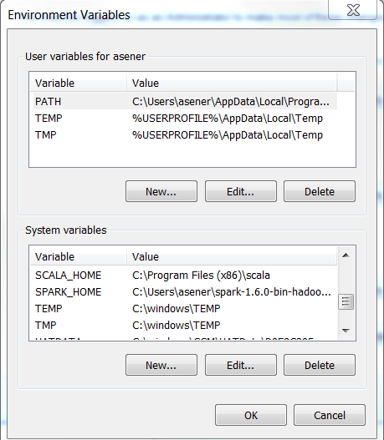
Standalone Spark Installation: To Login spark-shell or pyspark (shell)
Navigate to Computer → System Properties → Advanced System Settings
Advanced Tab → Environmental variables
sudo vi ~/.bashrc
After lines below…
#Spark Configurations
export SPARK_HOME=/opt/spark-2.3.1-bin-hadoop2.7 export PATH=$PATH:$SPARK_HOME/bin #Pyspark Configurations export PYSPARK_PYTHON=/usr/bin/python3 export PYSPARK_DRIVER_PYTHON=notebook
You need all 4 variables on the left as in Linux & MacOS
After saving…
source ~/.bashrc

Slide 67
Shark (Hive on Spark Execution Engine)
Shark was an older Hive-on-Spark project out of the University of California, Berkeley.
Shark modified Apache Hive to run on Spark Execution Engine, previously it was supporting MapReduce and Apache Tez Execution Engines.
It has now been replaced by Spark SQL to provide better integration with the Spark engine and language APIs. Therefore, it is recommended to use Spark SQL directly, instead of Shark.

Slide 68
Shark versus other Big Data SQL Tools Benchmarking
System | SQL variant | Execution engine | UDF Support | Mid-query fault tolerance | Open source | Commercial support | HDFS Compatible
Hive | Hive QL (HQL) | MapReduce | Yes | Yes | Yes | Yes | Yes
Tez | Hive QL (HQL) | Tez | Yes | Yes | Yes | Yes | Yes
Shark | Hive QL (HQL) | Spark | Yes | Yes | Yes | Yes | Yes
Impala | Some HQL + some extensions | DBMS | Yes (Java/C++) | No | Yes | Yes | Yes
Redshift | Full SQL 92 (?) | DBMS | No | No | No | Yes | No
Ref: https://amplab.cs.berkeley.edu/benchmark/#

Slide 69
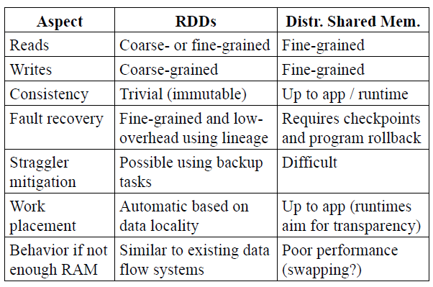
Spark RDDs versus a standard Distributed Shared Memory Implementation
Ref: Matei Zaharia et al. Resilient Distributed Datasets: A Fault-Tolerant Abstraction for In-Memory Cluster Computing. NSDI 2012.
Notes:
Ref:
Matei Zaharia et al. Resilient Distributed Datasets: A Fault-Tolerant Abstraction for In-Memory Cluster Computing. NSDI 2012.
Advantages of the RDD Model
To understand the benefits of RDDs as a distributed
memory abstraction, we compare them against distributed
shared memory (DSM) in Table 1. In DSM systems,
applications read and write to arbitrary locations in
a global address space. Note that under this definition, we
include not only traditional shared memory systems [24],
but also other systems where applications make finegrained
writes to shared state, including Piccolo [27],
which provides a shared DHT, and distributed databases.
DSM is a very general abstraction, but this generality
makes it harder to implement in an efficient and faulttolerant
manner on commodity clusters.
The main difference between RDDs and DSM is that
RDDs can only be created (“written”) through coarsegrained
transformations, while DSM allows reads and
writes to each memory location.3 This restricts RDDs
to applications that perform bulk writes, but allows for
more efficient fault tolerance. In particular, RDDs do not
need to incur the overhead of checkpointing, as they can
be recovered using lineage.4 Furthermore, only the lost
partitions of an RDD need to be recomputed upon failure,
and they can be recomputed in parallel on different
nodes, without having to roll back the whole program.
A second benefit of RDDs is that their immutable nature
lets a system mitigate slow nodes (stragglers) by running
backup copies of slow tasks as in MapReduce [10].
Backup tasks would be hard to implement with DSM, as
the two copies of a task would access the same memory
locations and interfere with each other’s updates.
Finally, RDDs provide two other benefits over DSM.
First, in bulk operations on RDDs, a runtime can sched-
ule tasks based on data locality to improve performance.
Second, RDDs degrade gracefully when there is not
enough memory to store them, as long as they are only
being used in scan-based operations. Partitions that do
not fit in RAM can be stored on disk and will provide
similar performance to current data-parallel systems.

Slide 70


Directed Acyclic Graph (DAG) Model
Dryad and DryadLINQ (2007)
Michael Isard et al. Dryad: Distributed Data-Parallel Programs from Sequential Building Blocks, EuroSys, 2007
Spark (2010)
Matei Zahara et al. Spark: Cluster Computing with Working Sets, 2010
Matei Zaharia et al. Resilient Distributed Datasets: A Fault-Tolerant Abstraction for In-Memory Cluster Computing. NSDI 2012.
Notes:
Other Simple Explanations: http://data-flair.training/blogs/dag-in-apache-spark/
http://data-flair.training/blogs/apache-spark-vs-hadoop-mapreduce/
There are multiple advantages of Spark DAG, let’s discuss them one by one:
-The lost RDD can be recovered using the Directed Acyclic Graph.
-Map Reduce has just two queries the map, and reduce but in DAG we have multiple levels.so to execute SQL query, DAG is more flexible.
DAG helps to achieve fault tolerance. Thus the lost data can be recovered.
-It can do a better global optimization than a system like Hadoop MapReduce.
Spark’s lineage-based recovery mechanism is also similar to the recovery mechanism used within a computation (job) in MapReduce and Dryad, which track dependencies among a DAG of tasks. However, in these systems, the lineage information is lost after a job ends, requiring the use of a replicated storage system to share data across computations. In contrast, RDDs apply lineage to persist in-memory data efficiently across computations, without the cost of replication and disk I/O. (Matei Zaharia et al. Resilient Distributed Datasets: A Fault-Tolerant Abstraction for In-Memory Cluster Computing. NSDI 2012.)

Slide 71

What is new on Apache Spark 2.3?

Slide 72







Reference Apache Spark Book Recommendations
EVERYTHING IS IN PYTHON
MOSTLY IN SCALA, EXTENSIVE REFERENCES
THIS ONE IS AVAILABLE IN IE CAMPUS

Slide 73



Python Book Recommendations
THIS BOOK IS BASED ON MIT’S OPENCOURSEWARE,
MORE RELEVANT TO DATA SCIENCE
PYTHON IS NOT FULLY FUNCTIONAL, THIS BOOK IS
IN OUR ONLINE CAMPUS
ONE OF THE BEST BOOKS
EVER WRITTEN IN PYTHON,
GREAT FOR INTERVIEWS

